Slide 1
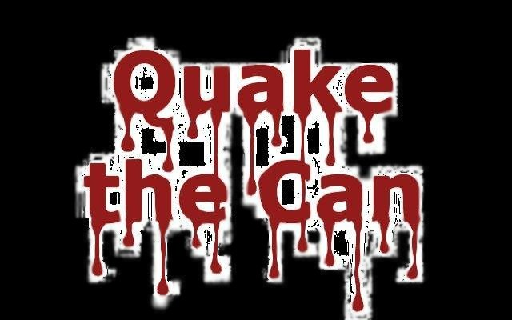
INSERT PICTURE HERE
Real-time 3D Graphics
Colorful characters battle it out to who see will rein supreme!
Based on the popular children’s game “Kick the Can”
Challenging AI always keeps you guessing!
Open Source! That makes it cool
INSERT PICTURE HERE

